Slide 1

Crypto Price Prediction Group D

Slide 2
Team members
Name | Role/ Expertice
Rodrigo Velazquez | Project Manager/Data Scientist
Bibek | Software Engineer
Mayisha | Machine Learning Engineer
Venkat | Software Engineer
Janani | Quantitative Analyst
Urjeet | Quality Assurance Engineer
Isha | Data Scientist
Tina | Quantitative Analyst

Slide 3
Why this topic?
We choose this topic for some reasons:
1-Our main topic included image processing which supposed a more advance project with topics that we still haven’t seen on college, so we decided to choose a project that let us put in practice some of the concepts we’ve seen so far.
2-Considering that the majority of projects in school tend to be about house pricing or health, we wanted to avoid the common projects.
3-It could be very interesting to create our own model and use it to predict the prices trends for cryptos with an up to date dataset.

Slide 4
Scope and goals
In simple terms based on the historical data of the cryptocurrency prices we want to predict the trend of prices for the future values of the price.
In order to do this we need a model to train and a dataset to train that model.

Slide 5
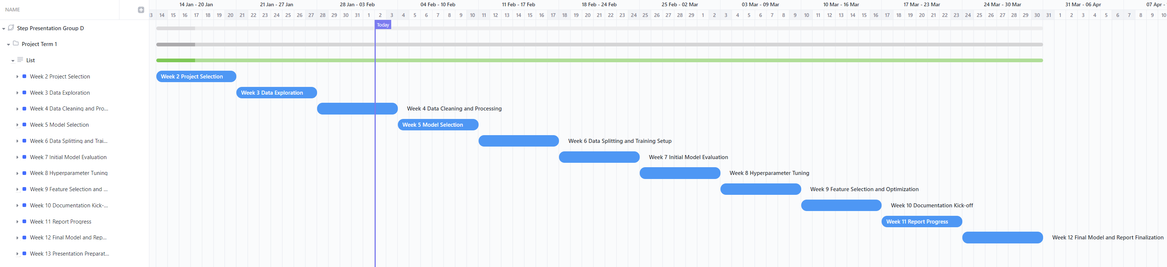
Gant Diagram
For the PM of this project we are using ClickUp to assign roles, workload, see the deliverables for each week, develop a timeline and gantt charts.
https://app.clickup.com/9017184916/v/g/8cqemmm-417

Slide 6
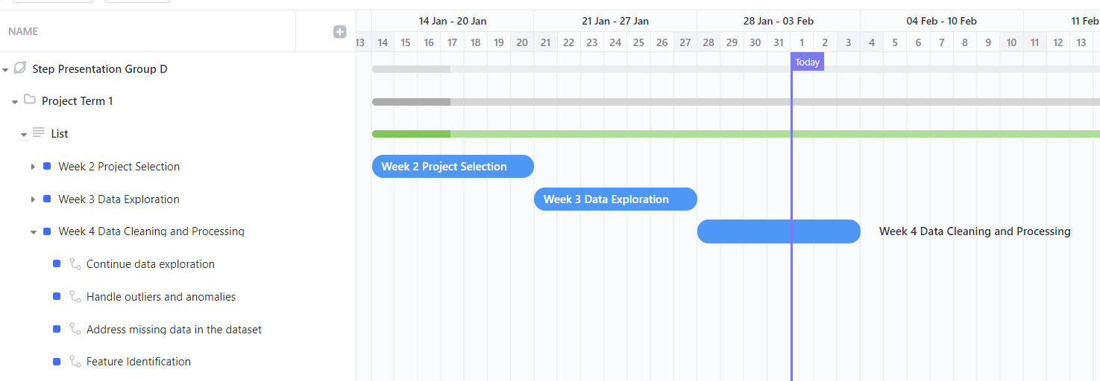
Where we are today
As seen from our gant diagram, on week 4 we continue with the data exploration, we searched for outliers and anomalies as well, we identified missing data.

Slide 7
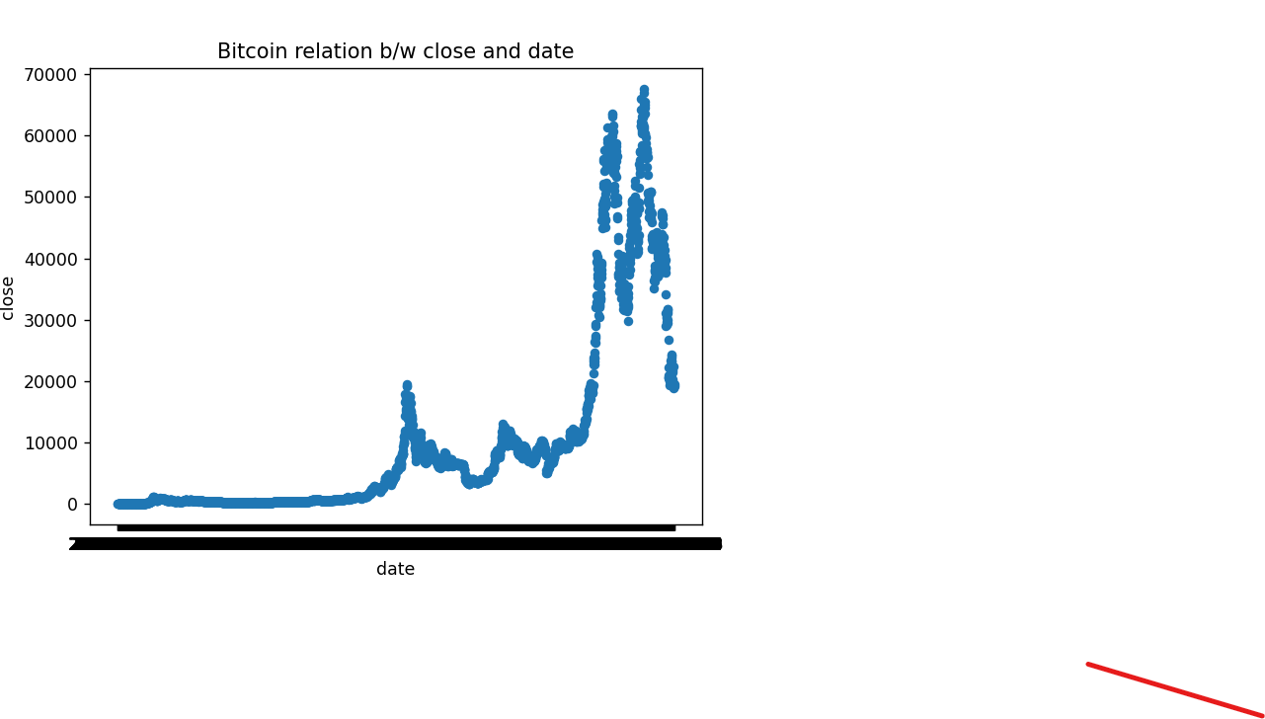
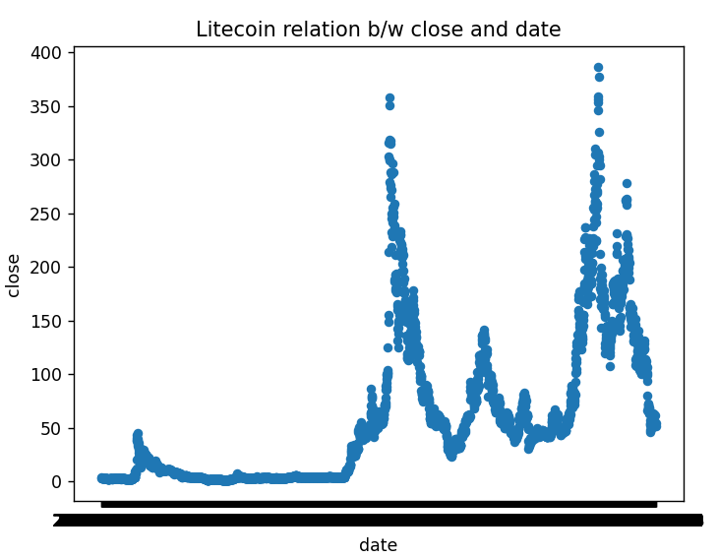
Findings
Scattere plot b/w colse value and date for BitCoin
Scattere plot b/w colse value and date for BitCoin
No Null (or) Empty values, Missing data in any of the column in the dataset.

Slide 8
What is training in ML
Firstly, let’s explain what is ML and what does it mean to train a model.
In Machine Learning(ML) the machines learn a relationship between input data and the desired output for input data based on an algorithm.
Machine learning uses supervised, unsupervised and reinforcement learning techniques.
Supervised learning trains a model based on an algorithm using existing data and corresponding output labels or values and then the trained model is used to make predictions on new data samples.
In our particular case given that the data that we are using is a continuous set of numbers, we need to use supervised training to accomplish a regression.

Slide 9
What is a regression
A statistical method known as regression establishes a relationship between a dependent variable and one or more independent (explanatory) variables.
A regression model can show whether changes observed in the dependent variable are associated with changes in one or more of the explanatory variables.
In essence, it fits a best-fit line and observes how the data is distributed around it to do this.
It helps the analyst to help to make asset valuations and making prediction.
There are two basic regression types Linear and Multiple linear regression.

Slide 10
What is Cryptocurrency
Cryptocurrency, or crypto, is a digital payment platform that eliminates the need to carry physical money. It exists only in digital form, and although people mainly use it for online transactions, you can make some physical purchases. Unlike traditional money printed only by the government, several companies sell cryptocurrency.
Transactions are then verified and recorded on a blockchain, an unchangeable ledger that tracks and records assets and trades.
Cryptocurrency is available as coins or tokens. The difference between them is that tokens are assets that exist on a blockchain, while coins can be virtual, digital, or tangible.

Slide 11
The data itself
We retrieved our data from Kaggle, which is a subsidiary from Google, and it’s an online community for engineers of all fields, that allows the users to find and access datasets used to build AI models.
This is the link for our dataset: https://www.kaggle.com/datasets/maharshipandya/-cryptocurrency-historical-prices-dataset
Now let’s see the data itself!

Slide 12
The Dataset
It contains 9 columns
It contains 72946 registers or rows
It contains info for 56 different cryptos
The start and end date for our data is 2013-05-05 / 2022-10-23
Some potential challenges we saw during the exploration were: Value of crypto totally depends upon the investor and market demands. So, market value can highly be affected by external factor as well.
The columns that we would be using to train our model probably are: open, low, high, close, volume, crypto name, date

Slide 13
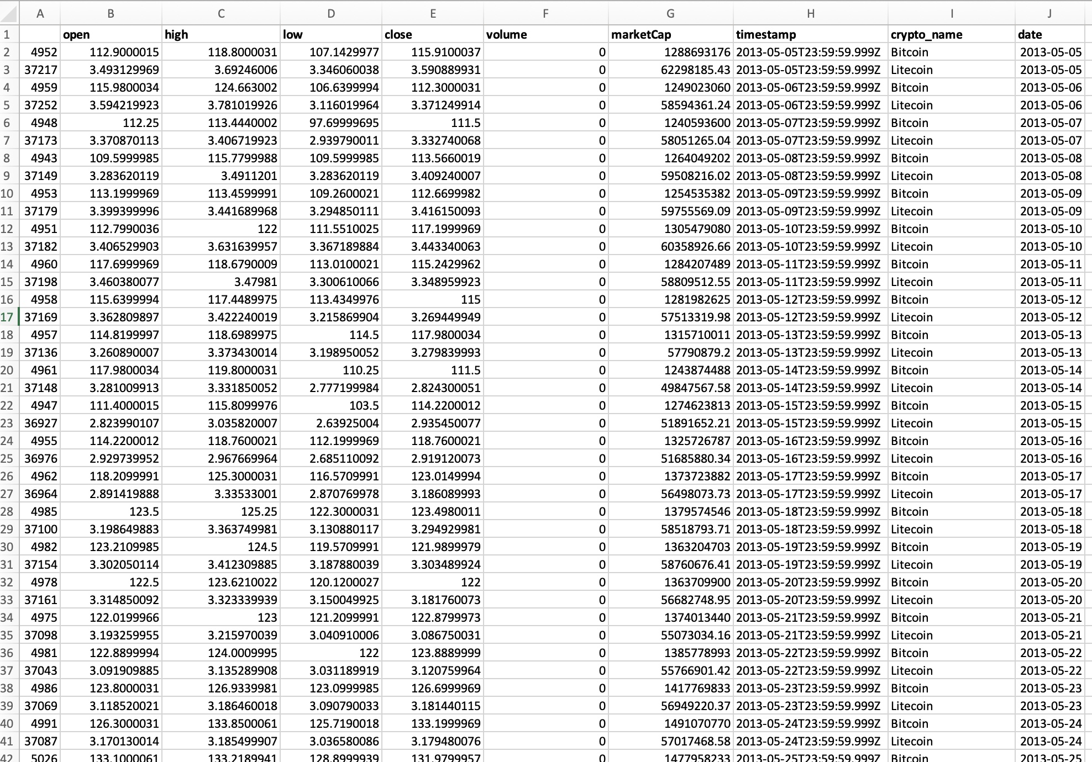
The Dataset

Slide 14
Exploring the data
In order to start the data exploration, we mixed our group with Leandro’s group during the weekend to deliver 2-hour training on: Jupyter notebook, pandas and python.
By doing so we give each member of both teams the basic tools they need to access and start manipulating the data.
Link to the training recording:

Slide 15
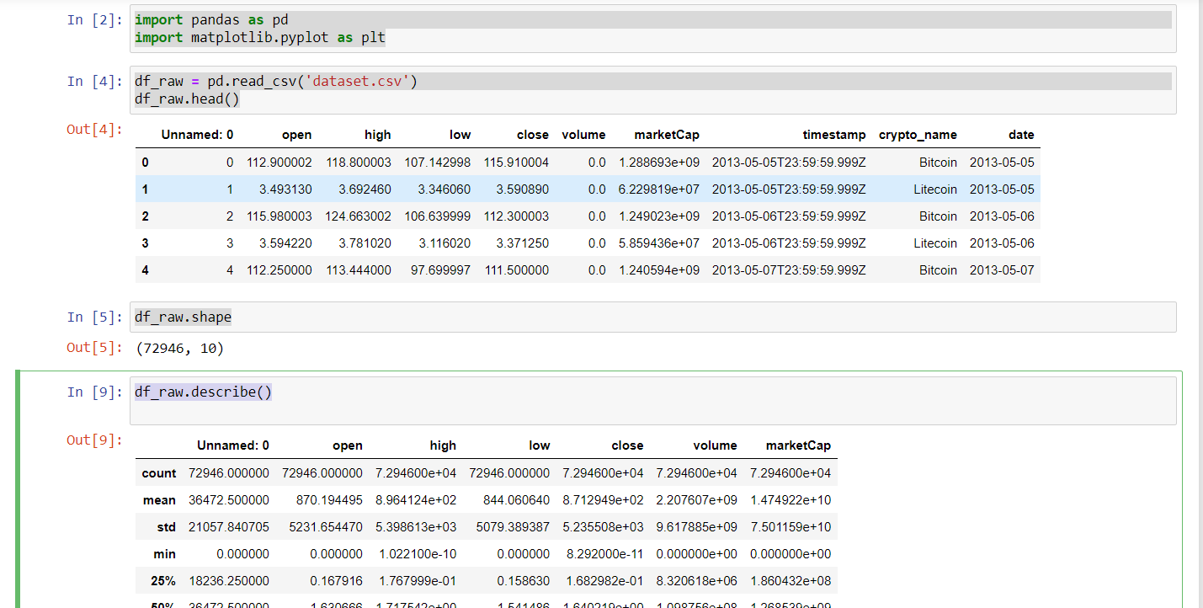
Data accessing and exploration code
The provided code and explanations showcase the initial steps of data analysis using Python libraries.
By importing Pandas as `pd` and Matplotlib's pyplot as `plt`, the script establishes a foundation for data manipulation and visualization. The subsequent use of `pd.read_csv('dataset.csv')` loads tabular data from a CSV file named 'dataset.csv' into a DataFrame named `df_raw`.
This DataFrame acts as a structured table, making it easy to work with rows and columns of data. The command `df_raw.head()`
offers a glimpse of the first few rows, providing a quick overview of the dataset's content. Additionally, `df_raw.shape` is employed
to reveal the dimensions of the DataFrame, specifying the number of rows and columns.
Finally, `df_raw.describe()` generates a statistical summary, presenting key metrics like mean, standard deviation, and
quartiles for numerical columns. Collectively, these steps lay the groundwork for further exploration and analysis of the dataset,
offering insights into its structure and statistical characteristics.

Slide 16
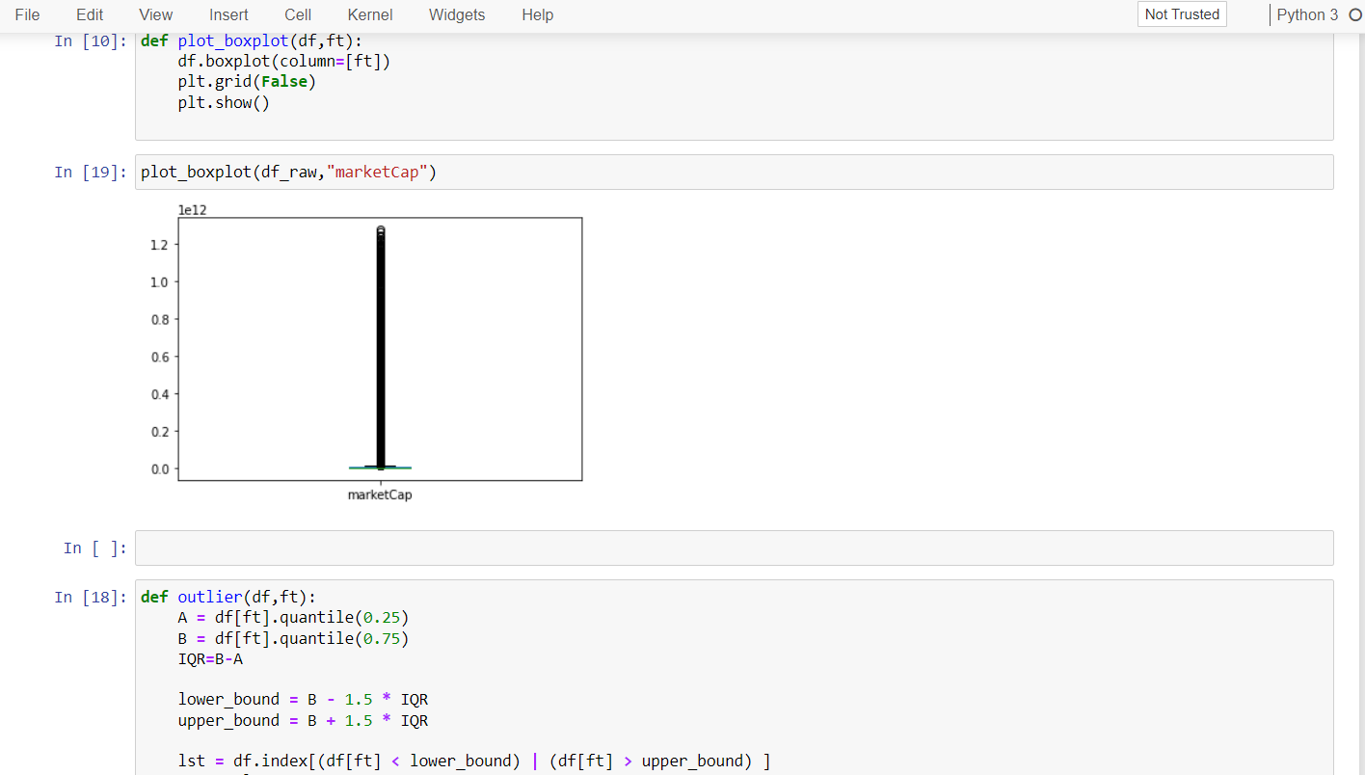
The provided code and explanations are like a recipe for analyzing data. There's a special function called `plot_boxplot` that makes graphs called boxplots, helping us understand how data is spread out. Inside this function, it uses tools from a library called Pandas to create the actual plot and make it look clean by removing gridlines. The result is shown on the screen. When we use this function with the command `plot_boxplot(df_raw, "marketCap")`, it makes a boxplot specifically for the "marketCap" column in our data. Additionally, there's another tool introduced to find potential unusual values in the data, called outliers. These outliers are identified based on specific rules using percentiles and ranges. The code then creates a list of positions where these outliers are found. This approach helps us clean up the data by removing potential outliers, making it more reliable for further analysis. So, it's like a step-by-step guide for understanding and cleaning up data using visualizations and statistical methods.

Slide 17
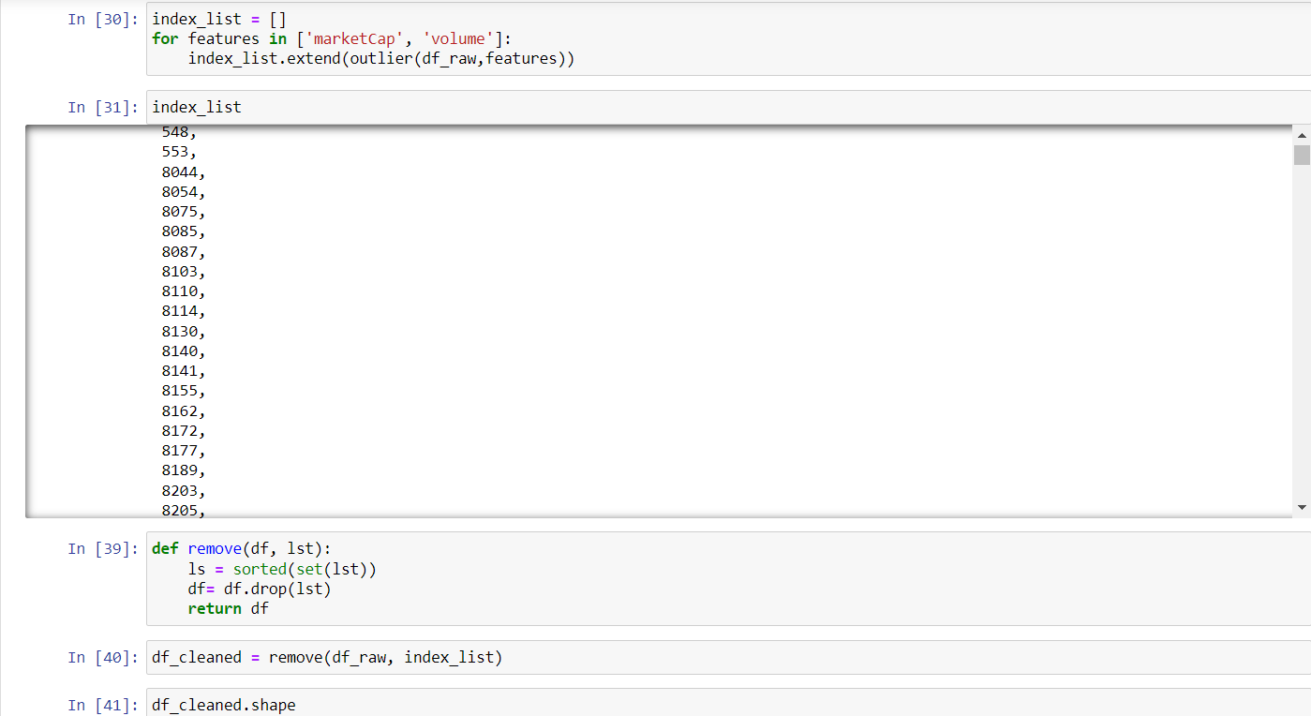
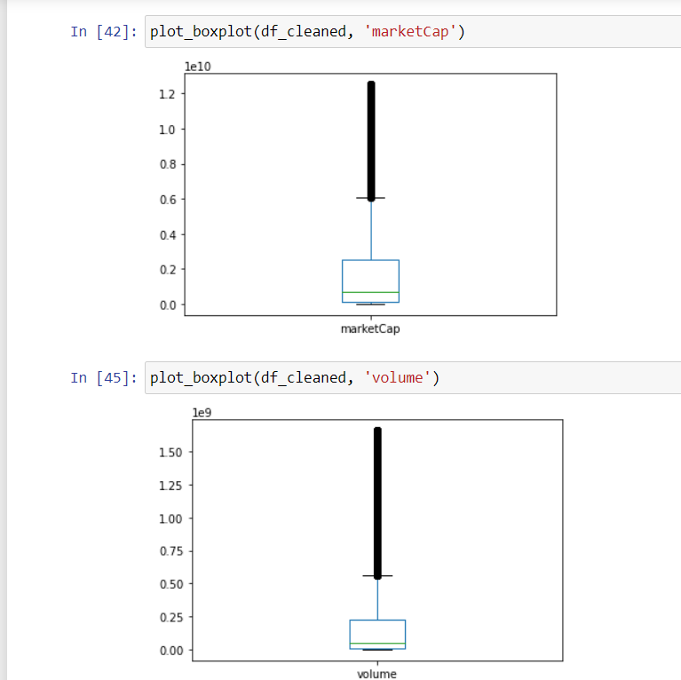
This code explain how to find and deal with unusual values, called outliers, in a dataset using Python. Initially, an empty list, `index_list`, is created to remember the positions of these unusual values. The code looks at two features, 'marketCap' and 'volume', and figures out which rows have unusual values for each feature. The positions of these unusual values are stored in `index_list`. Then, this list is organized to keep only the unique positions and sorted in order. Using this sorted list, rows with unusual values are removed from the original dataset, creating a cleaned dataset called `df_cleaned`. Finally, boxplots are made for both 'marketCap' and 'volume' in the cleaned dataset, helping to see how the data looks after getting rid of the unusual values. This process is like cleaning up the data to make sure it's reliable and ready for analysis.

Slide 18
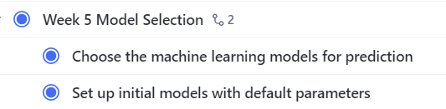
Next Steps
In week 5 our next milestone is to start with the model selection

Slide 19
Thanks
Questions?

